Slide 1
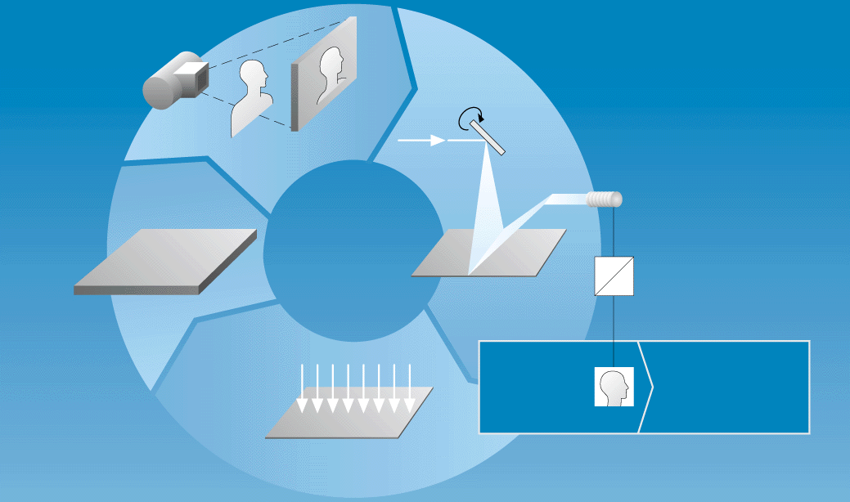
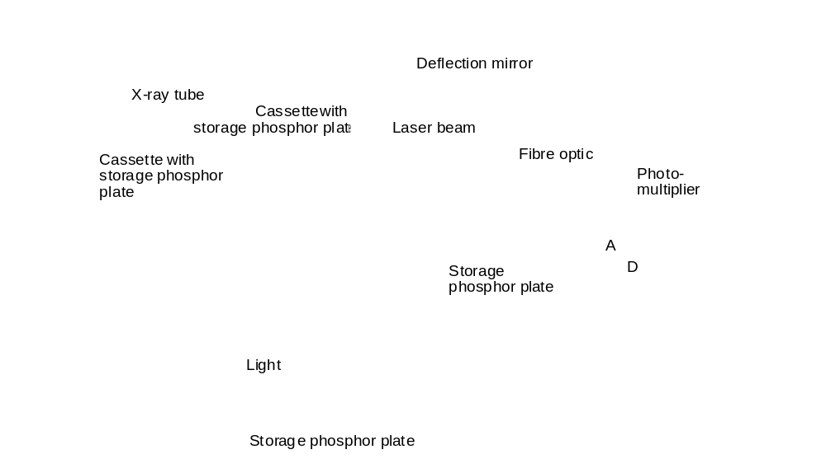
Process of Storage Phosphor Plates
Protective layer
Phosphor layer
(BaFBr: Eu ²⁺)
Support
Barcode
a
t
i
o
n

Slide 2
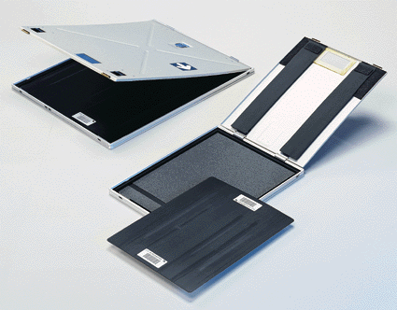
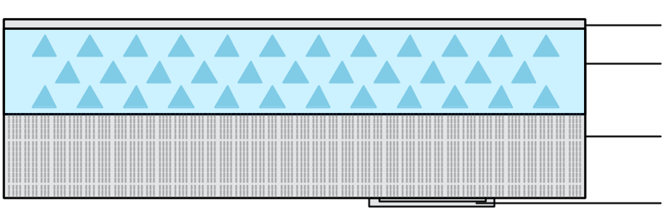
Structure of a Storage Phosphor Plate
Protective layer
Phosphor layer
(BaFBr: Eu ²⁺)
Support
Barcode

Slide 3
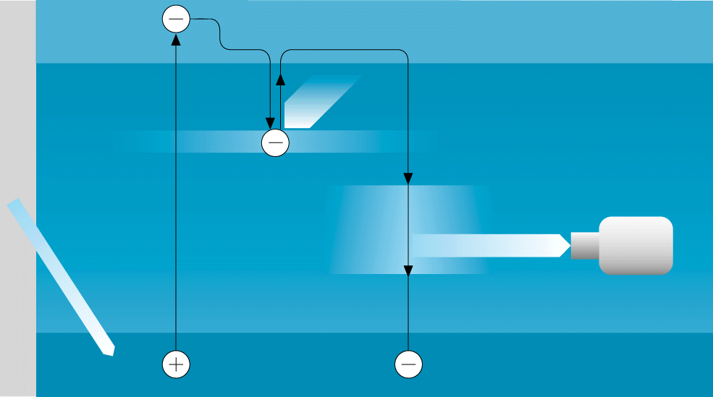
How a Storage Phosphor Plate Works
Conduction band
Laser
T
raps
e–
Photo-
multiplier
X-ray beam
Stimulated
light
Europium
Valence band

Slide 4
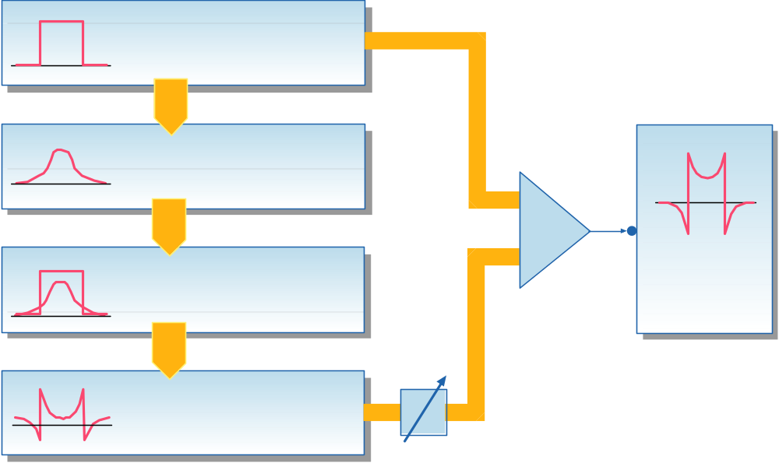

Digital Spatial Frequency Filtration = Edge Enhancement
Original image
Blurred mask (RN)
Edge-
enhanced
image
Original image minus
blurred mask
Differential image
(RE)
MED 96 555e

Slide 5
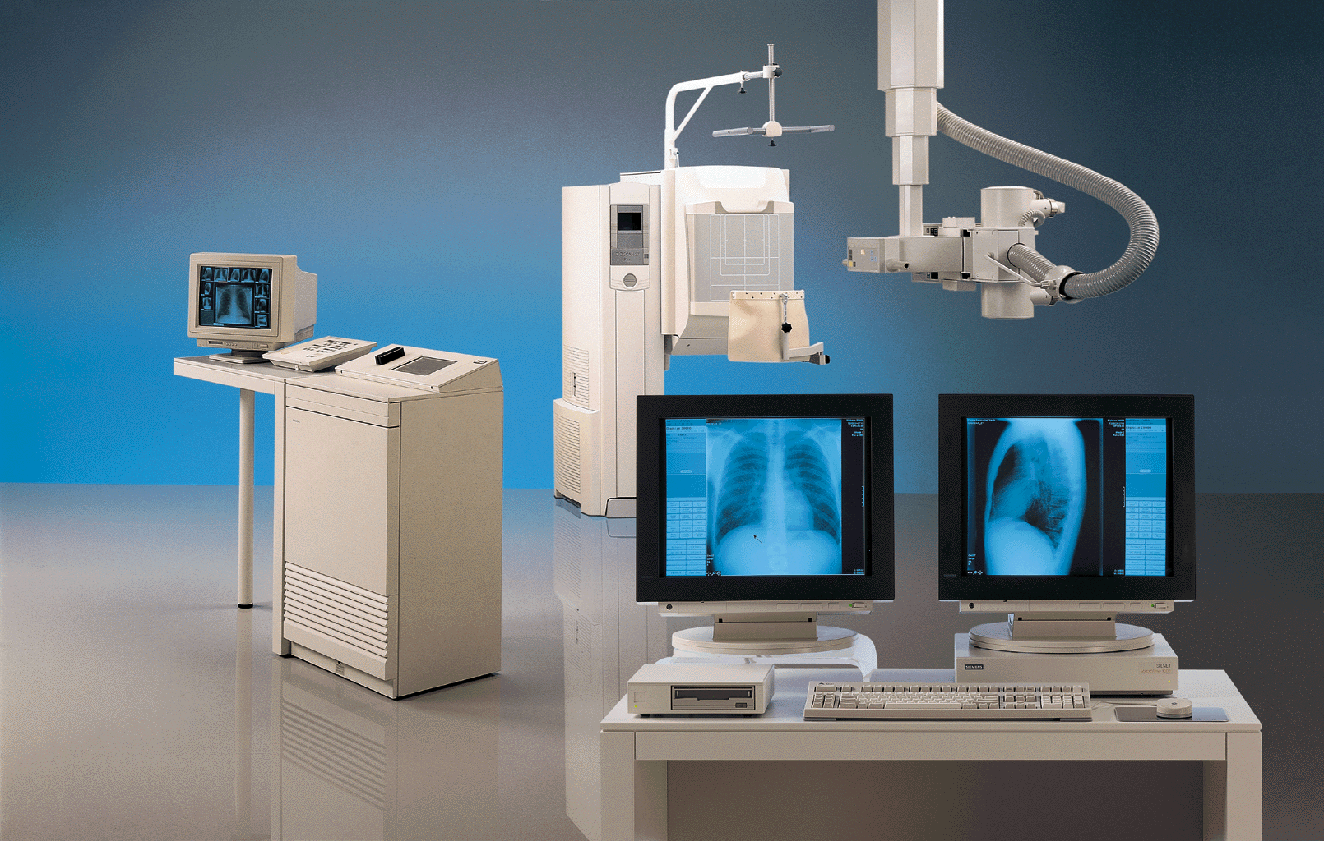
DIGISCAN 2T Plus –
Digital Cassette-Free Chest Imaging Workstation
Complete system consists of:
– ID console
– Upright chest imaging system and overhead tube support
– Generator
– MAGICVIEW diagnostic console
with interface for connecting
a laser camera
– Optical disk drive for image storage
Max. system throughput with
diagnosis at the monitor:
up to 110 imaging plates per hour
Wait time between imaging plates (exposures): approx. 15 s
Rotatable overhead tube support for bedside exposures
DICOM compatible
High patient throughput

Slide 6
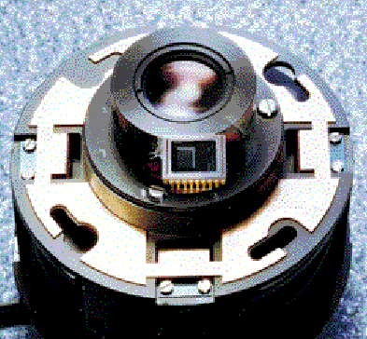
Excellent Image Quality with the State-Of-The-Art TV
Systems VIDEOMED DI or VIDEOMED SX
Uniform image brightness
independent of object density
through automatic dose rate
control and/or gain control
VIDEOMED DI
for digital fluoroscopy. TV system
features maintenance-free CCD technology,
ensuring high operational safety,
long life as well as minimal geometric
distortion and vignetting
VIDEOMED SX
The high-line multi-norm TV sytem features
high resolution and signal dynamics,
self-adjustment and self-test during operation.
Prerequisite for connecting FLUOROSPOT H

Slide 7
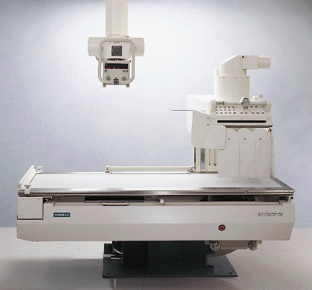
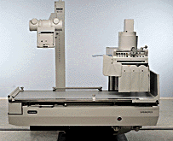
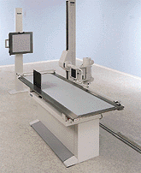
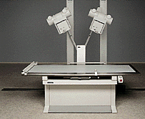
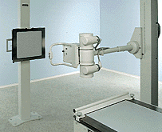
Tailored to Individual Requirements
Through Various Optional Components

